Slide 1
All possible paths in a Graph
PRESENTED BY,
Roopa L
Nandini D
Roshini Prasad

Slide 2
Contents
INTRODUCTION
METHODS
TIME COMPLEXITY
CONCLUSION
REFERENCE

Slide 3
Introduction
Given a Graph G = (V,E) and a source vertex v_{s}єV, find the shortest path and shortest distance from v_{s} to every other vertex v_{d} in V (v_{d} is the destination node).
Clearly, when we search for the shortest path, we must consider all the vertices in V.
If a vertex says v_{i} is ignored, then we will not consider any of the paths from v_{i} to v_{d} through v_{i}.

Slide 4
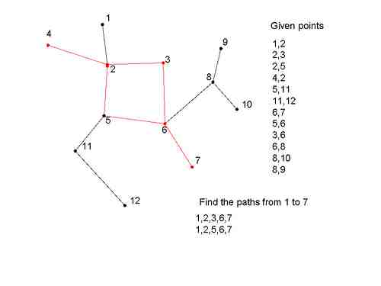
Find all paths from source to destination
on undirected graph using DFS

Slide 5
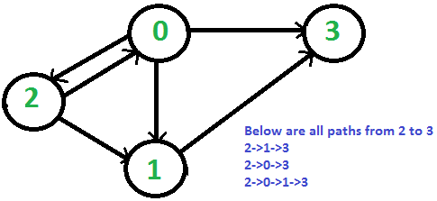
Find all paths from source to destination
On directed graph using DFS
 | 0 | 1 | 2 | 3
0 | 0 | 1 | 1 | 1
1 | 0 | 0 | 0 | 1
2 | 1 | 1 | 0 | 0
3 | 0 | 0 | 0 | 0

Slide 6
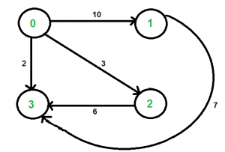
Find all paths from source to destination with exactly k
edges on directed weighted graph using DFS
For example consider the following graph. Let source ‘u’ be vertex 0, destination ‘v’ be 3 and k be 2. There are two walks of length 2, the walks are {0, 2, 3} and {0, 1, 3}. The shortest among the two is {0, 2, 3} and weight of path is 3+6 = 9.

Slide 7
Find all paths from source to destination with exactly k edges
on directed weighted graph using Dynamic Programming
For example consider the following graph. Let source ‘u’ be vertex 0, destination ‘v’ be 3 and k be 2. There are two walks of length 2, the walks are {0, 2, 3} and {0, 1, 3}. The shortest among the two is {0, 2, 3} and weight of path is 3+6 = 9.

Slide 8
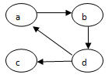
How to get the path matrix from adjacency matrix
using Dynamic programming
The adjacency matrix for the given graph is shown below:
 | a | b | c | d
a | 0 | 1 | 0 | 0
b | 0 | 0 | 0 | 1
c | 0 | 0 | 0 | 0
d | 1 | 0 | 1 | 0

Slide 9
In step 1 we are finding the path through a, ath row and ath column need to be considered. In step 2 bth row and bth column need to be considered and process is continued up to n vertices in a graph.
Step 1: since (d,a)=1 and (a,b)=1 and we make (d,b)=1.
Step 2: since (a,b)=1 and (b,,d)=1 and we make (a,d)=1.
since (d,b)=1 and (b,d)=1 and we make (d,d)=1.
Step 3: Note that (d,c)=1, from vertex c there is no path to any other nod. So the values have not been altered.
Step 4: since (a,d)=1 and (d,a)=1 and we make (a,a)=1.
since (a,d)=1 and (d,b)=1 and we make (a,b)=1.
since (a,d)=1 and (d,c)=1 and we make (a,c)=1.
since (a,d)=1 and (d,d)=1 and we make (a,d)=1.
since (b,d)=1 and (d,a)=1 and we make (b,a)=1.
since (b,d)=1 and (d,b)=1 and we make (b,b)=1.
since (b,d)=1 and (d,c)=1 and we make (b,c)=1.
since (b,d)=1 and (d,d)=1 and we make (b,d)=1.
The resultant table is shown below:

Slide 10
Step 1 step 2
 | a | b | c | d
a | 0 | 1 | 0 | 0
b | 0 | 0 | 0 | 1
c | 0 | 0 | 0 | 0
d | 1 | 1 | 1 | 0
 | a | b | c | d
a | 0 | 1 | 0 | 1
b | 0 | 0 | 0 | 1
c | 0 | 0 | 0 | 0
d | 1 | 1 | 1 | 1
Step3 step 4
 | a | b | c | d
a | 0 | 1 | 0 | 1
b | 0 | 0 | 0 | 1
c | 0 | 0 | 0 | 0
d | 1 | 1 | 1 | 1
 | a | b | c | d
a | 1 | 1 | 1 | 1
b | 1 | 1 | 1 | 1
c | 0 | 0 | 0 | 0
d | 1 | 1 | 1 | 1

Slide 11
All pair shortest paths uding Dynamic Programming
CASE 5 : In this section, let us see “ what is all pairs shortest path problem?” In all pair shortest path problem, we find the shortest distance from all nodes to all other nodes. The problem can be stated as follows:
Let G=(V,E) be a directed graph where V is set of vertices with n number of vertices and E is set of edges. Let cost be the cost adjacency matrix for the graph G such that
Cost(i,i)=0, for 0<=i<n
Cost(i,j) is the cost associated with the edge (i,j) if there is an edge from i to j.
Cost(i,j)=∞ if there is no edge from i to j.
The all pairs path problem is to determine a matrix D such that D(i,j) contains the shortest distance from i to j.
The above statement is changed to the following statement:
D[i,j]= min(D[i,j], D[i,k]+D[k,j])

Slide 12
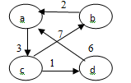
: All pair shortest path problem for the given digraph shown below.
The adjacency matrix for the given graph is shown below:
 | a | b | c | d
a | 0 | ∞ | 3 | ∞
b | 2 | 0 | ∞ | ∞
c | ∞ | 7 | 0 | 1
d | 6 | ∞ | ∞ | 0

Slide 13
Step 1: since (b,a)=2 and (a,c)=3.So, (b,c) = min{ (b,c) , (b,a) + (a,c) }
= min{∞, 2+3} = 5
since (d,a)=6 and (a,c)=3.So, (d,c) = min{ (d,c) , (d,a) + (a,c) } = min{∞, 6+3} = 9
Step 2: since (c,b)=7 and (b,a)=2.So, (c,a) = min{ (c,a) , (c,b) + (b,a) }
= min{∞, 7+2} = 9
since (c,b)=7 and (b,c)=5.So, (c,c) = min{ (c,c) , (b,c) + (c,b) } = min{0, 5+7} = 0
Step 3: since (a,c)=3 and (c,a)=9.So, (a,a) = min{ (a,a) , (a,c) + (c,a) }
= min{0, 3+9} = 0
since (a,c)=3 and (c,b)=7.So, (a,b) = min{ (a,b) , (a,c) + (c,b) } = min{∞, 3+7} = 10
since (a,c)=3 and (c,d)=1.So, (a,d) = min{ (a,d) , (a,c) + (c,d) } = min{∞, 3+1} = 4
since (b,c)=5 and (c,a)=9.So, (b,a) = min{ (b,a) , (b,c) + (c,a) } = min{2, 5+9} = 2
since (b,c)=5 and (c,b)=7.So, (b,b) = min{ (b,b) , (b,c) + (c,b) } = min{0, 5+7} = 0
since (b,c)=5 and (c,d)=1.So, (b,d) = min{ (b,d) , (b,c) + (c,d) } = min{∞, 5+1} = 6
since (d,c)=9 and (c,a)=9.So, (d,a) = min{ (d,a) , (d,c) + (c,a) } = min{6, 9+9} = 6
since (d,c)=9 and (c,b)=7.So, (d,b) = min{ (d,b) , (d,c) + (c,b) } = min{∞, 9+7} = 16
since (d,c)=9 and (c,d)=1.So, (d,d) = min{ (d,d) , (d,c) + (c,d) } = min{0, 9+1} = 0

Slide 14
Step 4: since (a,d)=4 and (d,a)=6 and we make (a,a)=0.
since (a,d)=4 and (d,b)=16 and we make (a,b)=10.
since (a,d)=4 and (d,c)=9 and we make (a,c)=3.
since (b,d)=6 and (d,a)=6 and we make (b,a)=2.
since (b,d)=6 and (d,b)=16 and we make (b,b)=0.
since (b,d)=6 and (d,c)=9 and we make (b,c)=5.
since (c,d)=1 and (d,a)=6and we make (c,a)=7.
since (c,d)=1 and (d,b)=16 and we make (c,b)=7.
since (c,d)=1 and (d,c)=9 and we make (c,c)=0.

Slide 15
The resultant table is shown below:
Step 1 step 2
 | a | b | c | d
a | 0 | ∞ | 3 | ∞
b | 2 | 0 | 5 | ∞
c | ∞ | 7 | 0 | 1
d | 6 | ∞ | 9 | 0
 | a | b | c | d
a | 0 | ∞ | 3 | ∞
b | 2 | 0 | 5 | ∞
c | 9 | 7 | 0 | 1
d | 6 | ∞ | 9 | 0
Step3 step 4
 | a | b | c | d
a | 0 | 10 | 3 | 4
b | 2 | 0 | 5 | 6
c | 9 | 7 | 0 | 1
d | 6 | 16 | 9 | 0
 | a | b | c | d
a | 0 | 10 | 3 | 4
b | 2 | 0 | 5 | 6
c | 7 | 7 | 0 | 1
d | 6 | 16 | 9 | 0

Slide 16
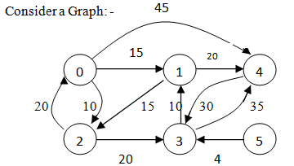
All pair shortest paths using Greedy Method
w | 0 | 1 | 2 | 3 | 4 | 5
0 | 0 | 15 | 10 | ∞ | 45 | ∞
1 | ∞ | 0 | 15 | ∞ | 20 | ∞
2 | 20 | ∞ | 0 | 20 | ∞ | ∞
3 | ∞ | 10 | ∞ | 0 | 35 | ∞
4 | ∞ | ∞ | ∞ | 30 | 0 | ∞
5 | ∞ | ∞ | ∞ | 4 | ∞ | 0
Cost adjacency matrix

Slide 17
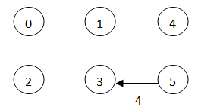
Obtain the shortest distance and shortest path from node 5 to node 1 in the above graph. Solution: Let source =5 and destination =0.
D | 0 | 1 | 2 | 3 | 4 | 5
5 | ∞ | ∞ | ∞ | 4 | ∞ | 0
 | 0 | 1 | 2 | 3 | 4 | 5
P | 5 | 5 | 5 | 5 | 5 | 5
Contains the initial distance from 5 to all other nodes.
Step 1: 5 to 3 is selected with distance 4

Slide 18
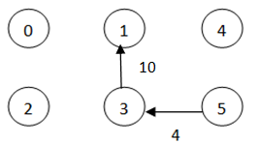
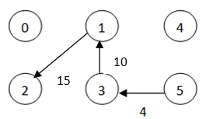
Step 2: Vertex 1 is selected with distance 14 p[1]=3 go to 1 through 3.
Step 3: Vertex 2 is selected with distance 29 p[2]=1 go to 2 through 1.

Slide 19
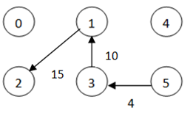
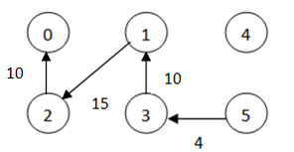
Step 4: Vertex 4 is selected. Since there is no change in p[4], it is not considered. So, no change in the path.
Step 5: Vertex 0 is selected with distance 49. In previous step we have p[0]=2 go to 0 through 2 as shown below.
The shortest distance from 5 to 0 is 49 using the path 5→3→1→2→0.

Slide 20
S | v=V-S | d[v]=min(d[v],d[u]+w[u][v]) | P[v]=u | Find u,d[u] such that d[u] is minimum and uєV-S
5 | 0,1,2,3,4 | − | − | 3,4
5,3 | 0,1,2,4 | d[0]=min(∞,4+∞)=∞ d[1]=min(∞,4+10)=14 d[2]=min(∞,4+∞)=∞ d[4]=min(∞,4+35)=39 | P[1]=3 P[4]=3 | 1,14
5,3,1 | 0,2,4 | d[0]=min(∞,14+∞)=∞ d[2]=min(∞,14+15)=29 d[4]=min(∞,14+20)=34 | P[2]=1 P[4]=1 | 2,29
5,3,1,2 | 0,4 | d[0]=min(∞,29+20)=49 d[4]=min(34,29+∞)=34 | P[1]=3 | 4,34
5,3,1,2,4 | 0 | d[0]=min(49,34+∞)=49 | − | 0,49
5,3,1,2,4,0

Slide 21
Methods
Find all paths from source to destination
on undirected graph using DFS
Begin:
Step 1: [read the number of vertices in the grapg]
Read n
Step 2: [Input the adjacency matrix]
For i←0 to n-1 do
For j←0 to n-1 do
Read a[i][j]
End for
End for
Step 3: [Input the vertex from where DFS should start and
destnation]
Read source
Read destination
Step 4: [Indicate that no node is visited]
For i←0 to n-1 do s[i]←0
Step 5:[Initiate DFS]
S[u]←1
k++ ; p[k]←u
if(u==d)
for k=0 to n
print”p[k]”
end for
end if
For v←1 to n do
if(a[u,v]==1and s[v]=0)
DFS(a,n,u,s,d,p)
End if
End for
S[v]=0 s[v-1]=0
e=p[k] k-- f=p[k] k—
DFS(a,n,v-1,s,d,p)
End

Slide 22
Find all paths from source to destination with exactly k
edges on directed weighted graph using DFS
Begin:
// Base cases
if (k == 0 && u == v) return 0;
if (k == 1 && graph[u][v] != INF) return graph[u][v];
if (k <= 0) return INF;
// Initialize result
int res = INF;
// Go to all adjacents of u and recur
for (int i = 0; i < V; i++)
if (graph[u][i] != INF && u != i && v != i)
int rec_res = shortestPath(graph, i, v, k-1);
if (rec_res != INF)
res = min(res, graph[u][i] + rec_res);
End if
End if
End for
return res;
End

Slide 23
Find all paths from source to destination with exactly k edges
on directed weighted graph using Dynamic Programming
if (e > 1)
for (int a = 0; a < V; a++)
// There should be an edge from i to a and a
// should not be same as either i or j
if (graph[i][a] != INF && i != a &&
j!= a && sp[a][j][e-1] != INF)
sp[i][j][e] = min(sp[i][j][e], graph[i][a] +
sp[a][j][e-1]);
end if
end for
end if
End for
End for
return sp[u][v][k];
End for
End
ALGORITHM : shortestPath(graph[][V], u, v, k)
Begin:
// Table to be filled up using DP. The value sp[i][j][e] will store
// weight of the shortest path from i to j with exactly k edges
int sp[V][V][k+1];
// Loop for number of edges from 0 to k
for (int e = 0; e <= k; e++)
for (int i = 0; i < V; i++) // for source
for (int j = 0; j < V; j++) // for destination
// initialize value
sp[i][j][e] = INF;
// from base cases
if (e == 0 && i == j)
sp[i][j][e] = 0;
if (e == 1 && graph[i][j] != INF)
sp[i][j][e] = graph[i][j];
//go to adjacent only when number of edges is more than 1

Slide 24
How to get the path matrix from adjacency matrix
using Dynamic programming
ALGORITHM : Transitive_Closure(n,A,P)
//Purpose: To Compute transitive closure
//Input: Adjacency matrix A of size nxn
//Output: Transitive closure of size nxn
Begin:
For k←0 to n-1 do
For i←0 to n-1 do
For j←0 to n-1 do
If( P[i,j]=0 and (If(P[i,k]=1 and P[k,j]=1))
P[i,j]=1
End if
End for
End for
End

Slide 25
All pair shortest paths uding Dynamic Programming
ALGORITHM : ALL_PAIRS_SHORTEST_PATH(n,C,D)
//Purpose: To implement floyd’s algorithm for all pairs
shortest paths problem
//Input: Cost adjacency matrix C of size nxn
//Output: Shortest distance matrix of size nxn
Begin:
For k←0 to n-1 do
For i←0 to n-1 do
For j←0 to n-1 do
D[i,j]=min{D[i,j], D[i,k]+D[k,j])
End if
End for
End for
End

Slide 26
All pair shortest paths using Greedy Method
Design an algorithm to find the single source shortest path problem using greedy technique.
ALGORITHM Single_Source_Shortest_Path(n,w,source,destination,d,p)
//Purpose: To compute the shortest distance and shortest
path from given source to destination..
//Input: n−Number of vertices in the graph
w− Cost adjacency matrix with values>=0
Source− source vertex
Destination− destination vertex

Slide 27
//Output: d− Shortest distance from source to all other
Nodes
p− Shortest path from source to destination
s− gives the nodes that are so far visited and the
nodes that are not visited
Begin:
S[source]=1 //add source to S
For i←1 to n-1 do
Find u and d[u] such that d[u] is
minimum and uє V-S add u to S
If (u=destination) break;
For every vє V-S do (i.e for v=0 to n-1)
If(d[u]+w[u,v]<d[v])
d[v]=d[u]+w[u,v]
p[v]=u
End if
End for
End for
End of algorithm

Slide 28
Time Complexity
Case 1: The time complexity of the algorithm to find all paths from source vertex to destination vertex is Ѳ(n²).
t α 2n²+5n+23
t α Ѳ(n²).
Case 2: The time complexity of the algorithm to find shortest path with k number of edges in a weighted graph is O(V^{k}) using DFS, where V is the number of vertices in the given graph.
t α n^{k}+28
t α O(n^{k}).
Case 3: Time complexity of the above DP based solution is O(V³K) which is much better than the naive solution.
t α 2kn³+2n³+6kn²+6n²+6kn+6n+2k+30
t α O(n³*k).

Slide 29
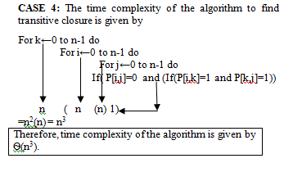

Slide 30
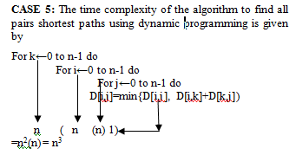


Slide 31
CASE 6 : The time complexity of the algorithm is considered with cost(weight) adjacency matrix and finding minimum in an unordered array.
Step 1: The parameter to be considered is n which represent the size of the input
Step 2: The basic statement is “if(d[u]+w[u,v]<d[v])” which is present in the innermost loop. This statement is executed once each time the control enters into the loop.
Step 3: The total number if times the basic statement is executed can be obtained as shown below:

Slide 32
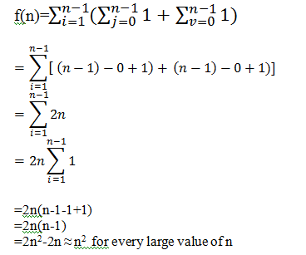
For i←1 to n-1 do
Find u and d[u] such that d[u] is minimum and
uє V-S add u to S
If (u=destination) break;
For every vє V-S do (i.e for v=0 to n-1)
If(d[u]+w[u,v]<d[v])

Slide 33
Graphs
A posteriori analysis
CASE 1
CASE 2

Slide 34
CASE 3
CASE 4

Slide 35
CASE 5
CASE 6

Slide 36
Number of vertices | Time in Units
 | Case 1 2n²+5n+23 | Case 2 n^{k}+28 | Case 3 2kn³+2n³+6kn²+6n²+6kn+6n+2k+30
3 | 56 | 55 | 486
4 | 75 | 92 | 1028
5 | 98 | 153 | 1756
6 | 125 | 244 | 2772
7 | 156 | 371 | 4120
8 | 191 | 540 | 5860

Slide 37
Number of vertices | Time in Units
 | Case 1 2n²+5n+23 | Case 2 n^{k}+28 | Case 3 2kn³+2n³+6kn²+6n²+6kn+6n+2k+30
3 | 56 | 55 | 486
4 | 75 | 92 | 1028
5 | 98 | 153 | 1756
6 | 125 | 244 | 2772
7 | 156 | 371 | 4120
8 | 191 | 540 | 5860

Slide 38
Conclusion
Here we wanted to find the all paths from source to destination vertex using DFS and also find the shortest paths from source to destination with exactly k number of edge using DFS and Dynamic programming and finally we find all pairs shortest paths using Dynamic programming for both directed and weighted graphs.
.

Slide 39
Thank you

